Slide 1

Software Developer
Bootcamp – Level 1
Job Board Brief
WE ARE DIGITAL NATIVE

Slide 2
Business Scenario
You are a developer tasked with creating a Proof of Concept for a job board site.
The site’s main screen lists jobs in its database.
The employer can then select buttons / menu options to deliver the following user stories:
As a visitor to the site, I need to see a list of jobs available on the site.
As an employer I need to be able to manage my profile / contact details so applicants can apply.
As an employer I need to be able to add a job to the list of advertised vacancies.
As an employer I need to be able to edit a vacancy I have posted.
As an employer I need to be able to delete a vacancy I have posted.
You have been provided with the wireframes on the following screens to help with your application design.
The Job Board branding should use Digital Native Green, Pink and Anthracite.
The job board should be able to load an example list of jobs from the client.

Slide 3
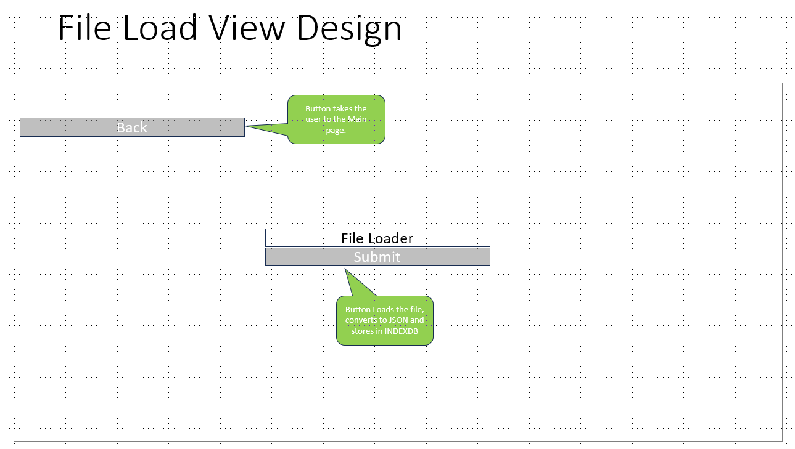
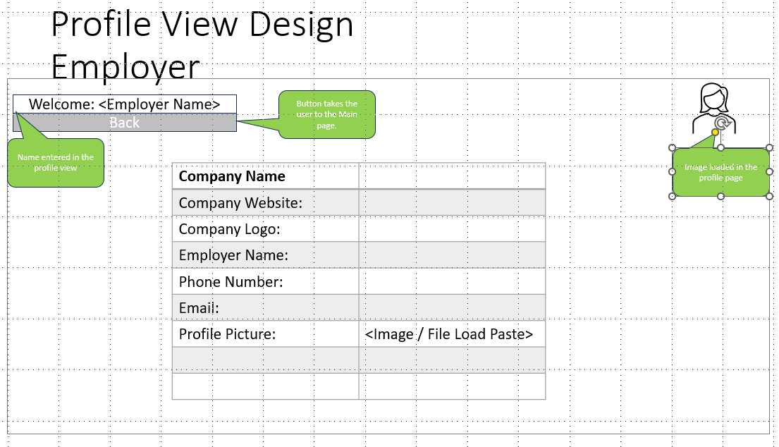
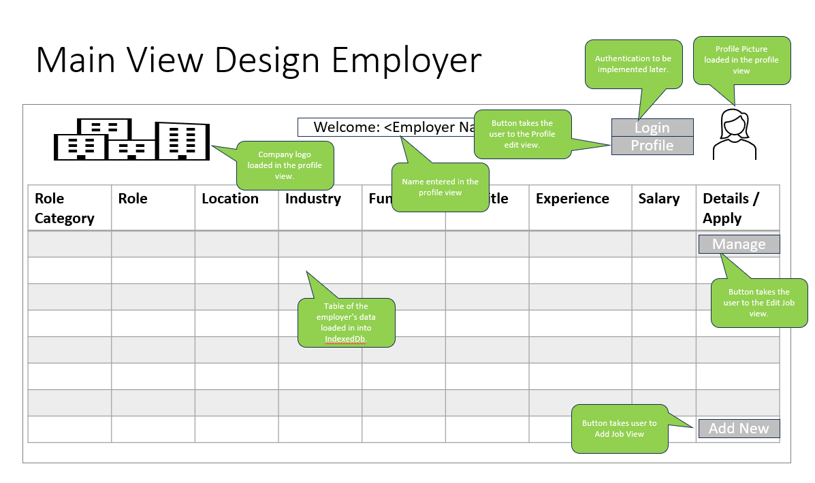
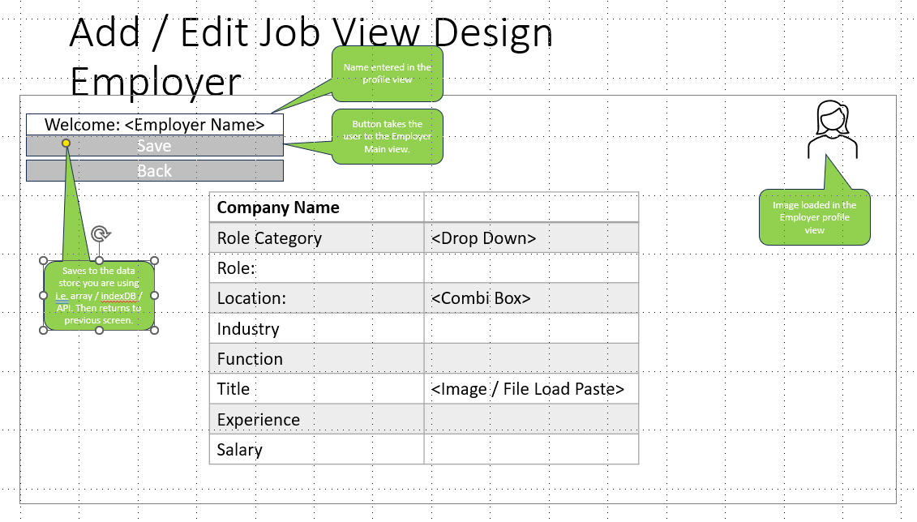
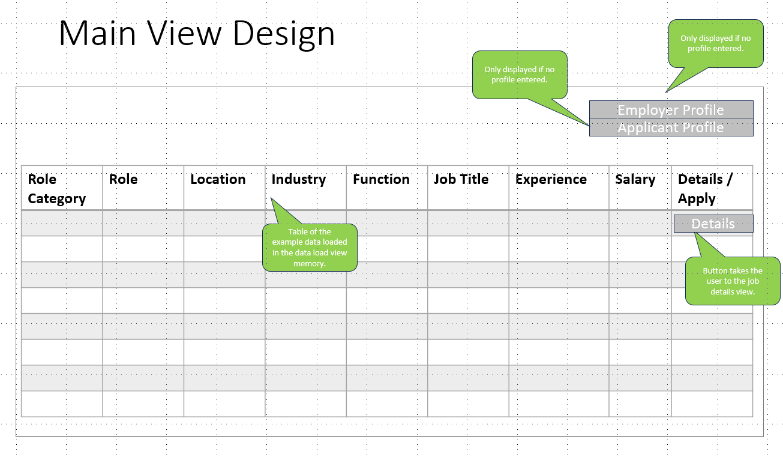
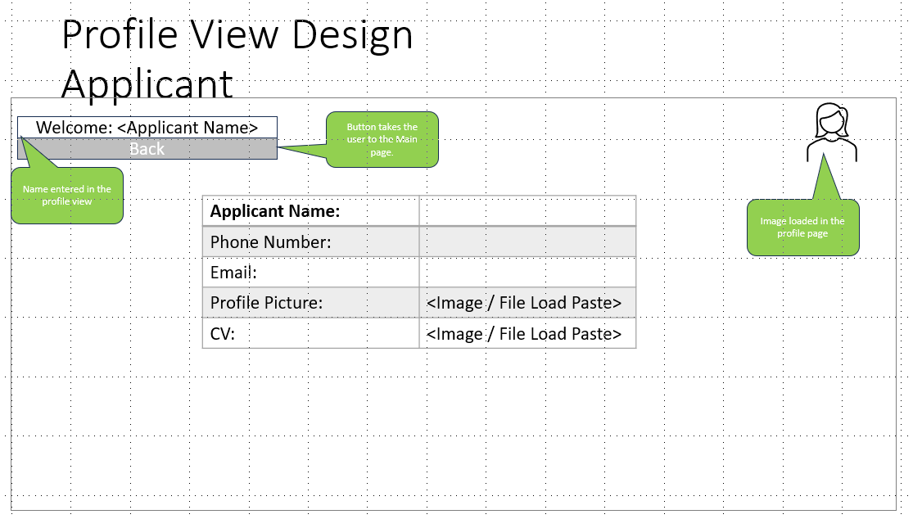
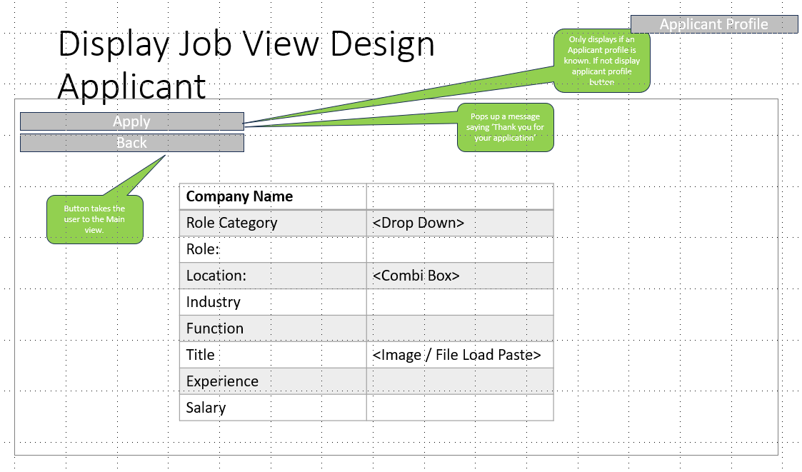
View Map
Load App
Push
Employer
Profile
Push
Add / Edit
Push
Back
Push
Back
Push
Back
Push Submit
Push
Applicant
Profile
Push
Details
Push
Back
Push
Back
Push
Back
Push
Details
Push
Back

Slide 4
File Load View Design
Button takes the user to the Main page.
Back
File Loader
Submit
Button Loads a CSV file, converts to JSON and stores in IndexedDb

Slide 5
Main View Design
Only displayed if no profile entered.
Only displayed if no profile entered.
Employer Profile
Applicant Profile
Role Category | Role | Location | Industry | Function | Job Title | Experience | Salary | Details / Apply
Details
Table of the Jobs data, stored in IndexedDb
Button takes the user to the Display Job view.

Slide 6


Main View Design Employer
Authentication to be implemented later.
Profile Picture loaded in the profile view
Button takes the user to the Profile edit view.
Welcome: <Employer Name>
Login
Company logo loaded in the profile view.
Profile
Name entered in the profile view
Role Category | Role | Location | Industry | Function | Job Title | Experience | Salary | Details / Apply
Manage
Button takes the user to the Edit Job view.
Table of the employer's data loaded in into IndexedDb.
Button takes user to Add Job View
Add New

Slide 7
Profile View Design
Employer
Welcome: <Employer Name>
Button takes the user to the Main page.
Back
Name entered in the profile view
Image loaded in the profile page
Company Name
Company Website:
Company Logo:
Employer Name:
Phone Number:
Email:
Profile Picture: | <Image / File Load Paste>
Each field saves when the user leaves the field. OnBlur

Slide 8
Profile View Design
Applicant
Welcome: <Applicant Name>
Button takes the user to the Main view.
Back
Name entered in the profile view
Applicant Name:
Phone Number:
Email:
Profile Picture: | <Image / File Load Paste>
CV: | <Image / File Load Paste>
Image loaded in the profile view
Each field saves when the user leaves the field. OnBlur

Slide 9
Add / Edit Job View Design
Employer
Name entered in the profile view
Welcome: <Employer Name>
Button takes the user to the Employer Main view.
Save
Back
Company Name
Role Category | <Drop Down>
Role:
Location: | <Combi Box>
Industry
Function
Title | <Image / File Load Paste>
Experience
Salary
Image loaded in the Employer profile view
Saves to the data store you are using i.e. array / indexDB / API. Then returns to previous screen.

Slide 10
Display Job View Design
Applicant
Applicant Profile
Only displays if an Applicant profile is known. If not display applicant profile button
Apply
Pops up a message saying ‘Thank you for your application’
Back
Company Name
Role Category | <Drop Down>
Role:
Location: | <Combi Box>
Industry
Function
Title | <Image / File Load Paste>
Experience
Salary
Button takes the user to the Main view.

